Slide 1
Module One
This version of the Module 1 PowerPoint presentation has been supplied in a simplistic format.
Facilitators can apply their own individual style and formatting and make changes to the order of slides, delete slides or add their own.
We would appreciate if a version of the acknowledgement slide is maintained.
A full reference list is available at the end of the presentation.

Slide 2
Add a title slide

Slide 3
Acknowledgement
This powerpoint presentation was developed by (or based on one developed by) Ms Amanda Semaan and Dr Jacqueline Raymond from the University of Sydney as part of a project funded by the Sydney Interdisciplinary Clinical Training Network.
The presentation is designed for educational purposes only.

Slide 4
Mental Health Placement
For now…
What are your thoughts?
Have you thought about what your placement might look like?
Later…
Have you thought about what would be your role as the EP?
Images sourced from Flicker.
The Italian voice (2008)
Keith Persall (2014)
David Goehring (2010)

Slide 5
Mental Health: What do you think?
People with mental health problems need to take ownership for their MH
Mental health problems don't affect me
Mental health problems are purely biological or genetic in nature
Mental health diagnosis are only for adults
I think people with mental illness are more likely to be violent
I think people with a mental illness are often in hospital
Nobody can force a mental health consumer to seek treatment
People with a mental illness are unpredictable
Mental illness is rare
Mental illness is untreatable
In this day and age, mental illness is accepted by communities
All people with a mental illness recover
When people with a mental illness complain about treatment in a hospital, they are just annoyed because they are in hospital
People with schizophrenia present with ‘two’ personalities
Mental health disorders are often life-long and difficult to treat
Stress causes mental illness
Electro-convulsive therapy (“shock treatment”) is a historic and barbaric treatment
Sane Australia (2015)
Government of Western Australia Mental Health Commission (2010)

Slide 6
Mental Health: What do you think?
Here is a comic created by Robot Hugs depicting some responses people with a mental health diagnosis have received… he has depicted the same response for physical health conditions…

Slide 7
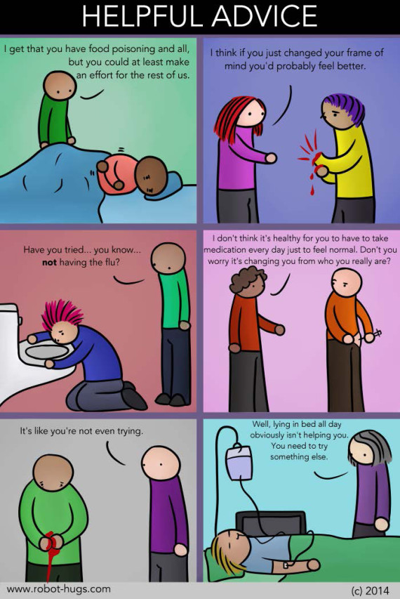
Mental Health: What do you think?
Image sourced from: Robot-Hugs (2013)

Slide 8
Mental Health: What does our community think?
Here we can view an Indian man speaking about his community and attitudes to mental illness:
http://www.healthtalk.org/peoples-experiences/mental-health/mental-health-ethnic-minority-carers-experiences/negative-attitudes-mental-health-problems
Health Talk (2014)

Slide 9
Mental Health: What do you think?
What about violence and mental illness?

Slide 10
What about violence and mental illness?
Mental disorders are neither necessary, nor sufficient causes of violence.
The major determinants of violence continue to be socio-demographic and socio-economic factors such as being young, male, and of lower socio-economic status.
Members of the public undoubtedly exaggerate both the strength of the relationship between major mental disorders and violence, as well as their own personal risk from the severely mentally ill. It is far more likely that people with a mental illness will be the victim of violence.
Substance abuse appears to be a major determinant of violence and this is true whether it occurs in the context of a concurrent mental illness or not. Those with substance disorders are major contributors to community violence, perhaps accounting for as much as a third of self-reported violent acts, and seven out of every 10 crimes of violence among mentally disordered offenders.
Finally, too much past research has focussed on the person with the mental illness, rather than the nature of the social interchange that led up to the violence. Consequently, we know much less than we should about the nature of these relationships and the contextual determinants of violence, and much less than we should about opportunities for primary prevention.
Stuart H (2003)

Slide 11
What about Violence and Serious Mental Illness?
Most individuals with serious mental illnesses are not dangerous.
Most acts of violence are committed by individuals who are not mentally ill.
Being a young male or being a substance abuser (alcohol or drugs) is a greater risk factor for violent behaviour than being mentally ill.
Individuals with serious mental illness are victimized by violent acts more often than they commit violent acts.
If people with serious mental illnesses are being appropriately treated, there is no evidence that they are any more dangerous than individuals in the general population.
Treatment Advocacy Centre (2011)

Slide 12
Challenging the stigma…
Any questions?

Slide 13
Reference for this picture
Anxiety
Schizophrenia
PTSD
Bipolar Disorder
Dual Diagnosis
PTSD
Depression
Personality Disorder
Image developed by Amanda Semaan

Slide 14
Person-centered language
People are not their illness
For example:
✗ Bob is schizophrenic
✔ Bob has schizophrenia
Ask your supervisor what the preferred terminology is (consumer? client? patient?)

Slide 15
Scenario: Kurt
Scenario: You are working with Kurt, a 19 year old male who recently experienced a drug induced psychosis. During his psychosis, he experienced paranoid ideation and believed that the government were following him.
From reading Kurt’s handover notes, you see he is recovering well but has yet to accept what has happened to him. While he is on an exercise bike, you speak with him about current events in the news to pass the time.
Kurt starts to talk about the recent missing Malaysia Airlines plane
How would you respond?

Slide 16
Role of an Exercise Physiology student on a MH Placement
General:
Challenge the ‘stigma’ associated with mental illness
Empower your clients through appropriate language
EP Specific:
Develop an understanding of the ‘profile’ of mental illness is Australia

Slide 17
Mental Illness- Background
What is mental illness: Mental illness is often categorised into three categories
Substance Abuse Disorders
Anxiety Disorders
Affective Disorders
Community v inpatient
$4.6 billion was spent on state and territory specialised mental health services, an average annual increase of 3.2% between 2008–09 and 2012–13. Of this, most was spent on public hospital services for admitted patients ($2.0 billion), followed by community mental health care services ($1.8 billion) (AIHW)
Around 8.7 million community mental health care service contacts were recorded in 2013–14.
Australian Institute of Health and Welfare (2014)

Slide 18
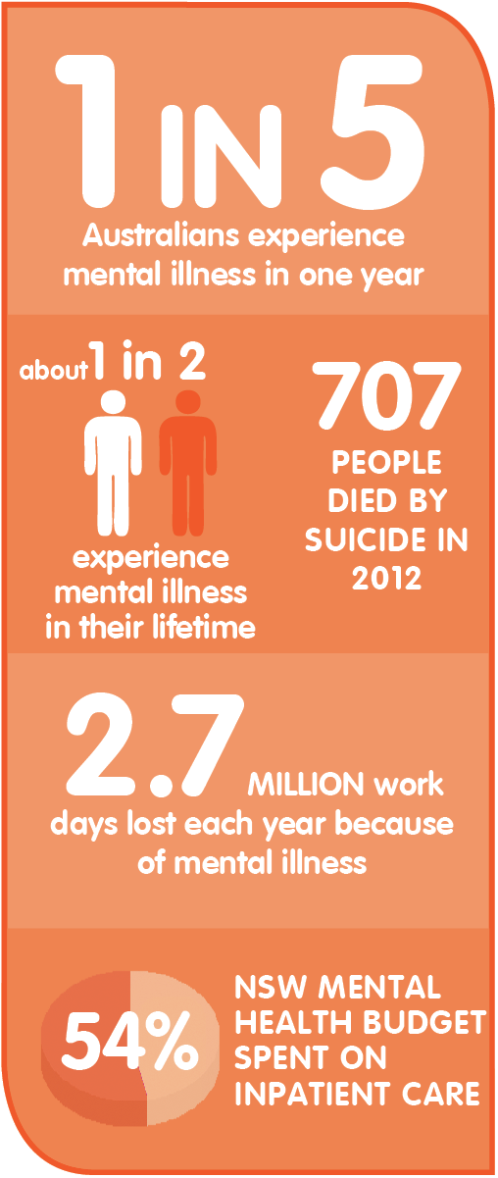
Who has a mental illness?
Images sourced from: Mental Health Commission (2014)

Slide 19
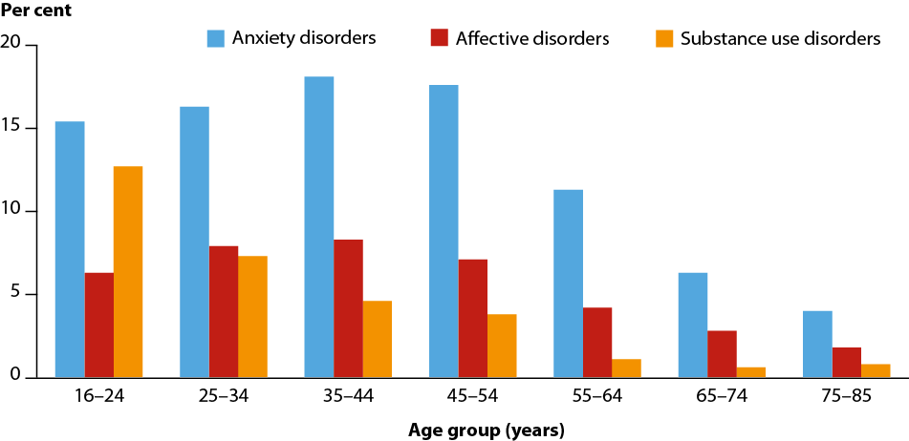
Who has a mental illness?
Australian Institute of Health and Welfare (2014)

Slide 20
Who has a mental illness?
Anxiety disorders are most common – 14.4%
Affective (mood) disorders - 6.2% (of which depression is 4.1%)
Substance use disorders – 5.1% (of which 4.3% is alcohol related).
Many people have more than one diagnosis.
Mindframe (2014)

Slide 21
Is mental illness life threatening???

Slide 22
Is mental illness life threatening?
Mental illness itself is not life-threatening.
Most people with mental illness recover well and are able to lead fulfilling lives in the community when they receive appropriate ongoing treatment and support.

Slide 23
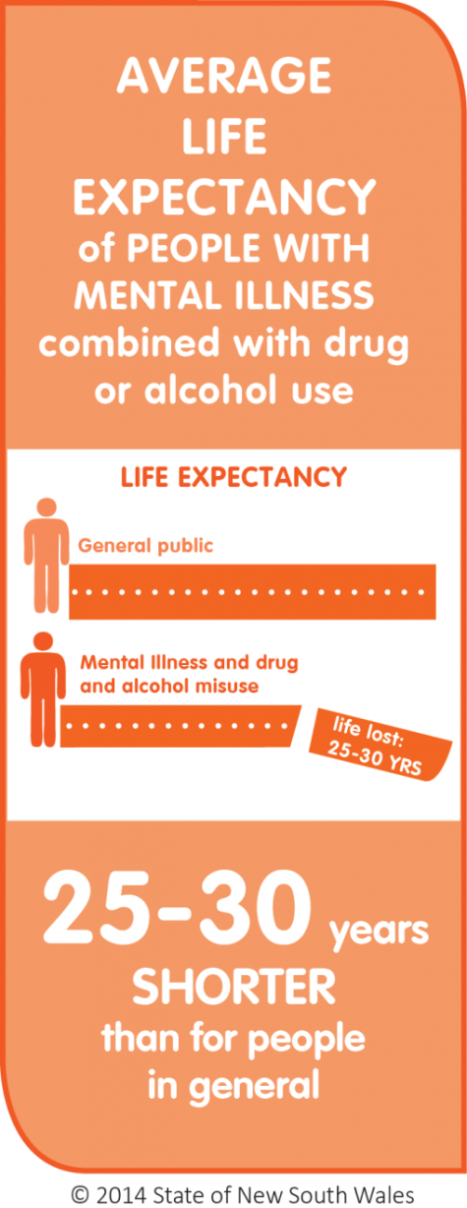
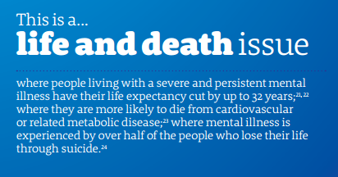
And yet….Life Expectancy in Australia
Images sourced from: Mental Health Commission (2014)

Slide 24
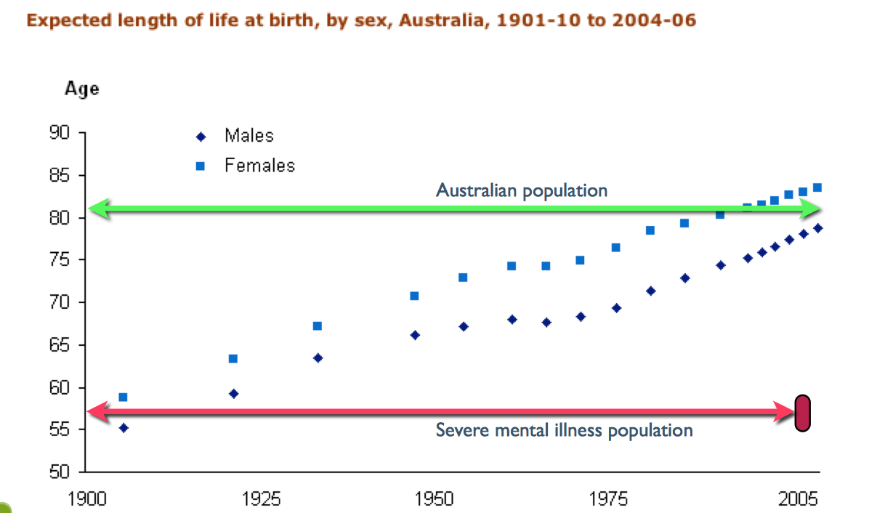
Life Expectancy in Australia
Lambert (2013)

Slide 25
Why????
Around 3% of adults experience psychosocial disability caused by the effects of mental illness ¹
People with severe (schizophrenia, bipolar disorder, mod-severe depression) mental disorders on average tend to die earlier than the general population. This is referred to as premature mortality. There is a 10- 25 year life expectancy reduction in patients with severe mental disorders (after accounting for suicide)²
The vast majority of these deaths are due to chronic physical medical conditions such as cardiovascular, respiratory and infectious diseases, diabetes and hypertension. The incidence of CV disease for people with schizophrenia remains unchanged.
Up to 15% of people seriously affected by mental illness eventually die by suicide (compared to an approximate figure of 1% for the whole population). Effective, ongoing treatment is essential to minimise the risk of suicide.¹
Death by misadventure
Sane Australia (2015)
World Health Organisation (2015)

Slide 26
Role of an Exercise Physiologist student on a MH Placement
General:
Challenge the ‘stigma’ associated with mental illness
Empower your clients through appropriate language
EP Specific:
Develop an understanding of the ‘profile’ of mental illness is Australia
Prevent, reduce &/or manage medication induced weight gain

Slide 27
SATIETY Study
Correll, 2009
US Cohort Study
205 participants <19 years, all antipsychotic-naive
12 week trial with:
Aripriprazole
Respiridone
Olanzapine
Quetiapine
Non-compliant control
Correll (2009)

Slide 28
SATIETY Study – 12 week outcomes
Primary Study Outcomes: | Weight Gain (lbs) | Weight Gain (%)
Quetiapine | 13.5 | 10.4%
Olanzapine | 19 | 15.2%
Aripiprazole | 9.9 | 8.1%
Risperidone | 11.9 | 10.4%
Non-Compliance | 0.4 | 0.7%
Correll (2009)

Slide 29
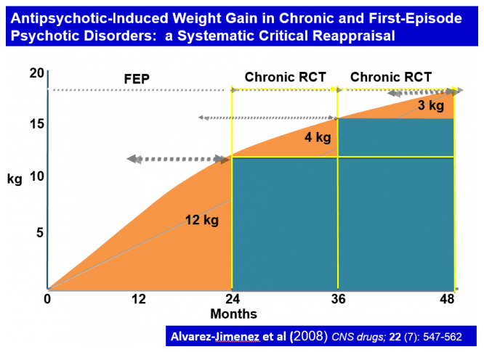
Weight gain is under-reported
Alvarez-Jimenez (2008)

Slide 30
Case Study - Kyle
Kyle is a 19 year old male hospitalised for first episode psychosis
He has experienced a delusional psychosis for the past four weeks
His delusions have been very torturous for Kyle- he believed he had harmed and sexually abused members of his family.
Medication has started to come into affect and Kyle has begun to experience periods of lucidity. He is experiencing ravenous hunger and large periods of sedation.
In the past four weeks, he has gained 7 kg whilst on the ward.
The psychiatrist recommends that Kyle begin seeing you asap. Kyle agrees to work with you.
What are your goals for Kyle?
What will your assessment include?
Provide an exercise prescription for Kyle

Slide 31
Case Study - Kyle
You go to run your first exercise session. Here is what may have happened:
Someone brings contraband on the ward and there has to be a full unit search
Someone needs to be restrained and everyone has to clear our from common areas, including Kyle.
Kyle has no memory of consenting to see you
Kyle breaks down regarding delusions about harming his sister
Kyle is meeting with the psychiatrist at the time of your appointment
Since making your appointment, Kyle has been approved for leave and has left the ward for 2 hours.
Kyle is able to see you for about 10 minutes before his focus and attention is too poor to continue
Kyle performs most of your program and thanks you for the session

Slide 32
Role of an Exercise Physiology student on a MH Placement
General:
Challenge the ‘stigma’ associated with mental illness
Empower your clients through appropriate language
EP Specific:
Develop an understanding of the ‘profile’ of mental illness is Australia
Prevent, reduce &/or manage medication induced weight gain
Facilitate engagement in activities that promote a healthy lifestyle

Slide 33
Prevalence of Co-morbid Chronic Disease & Mental Illness
So, is it all because of antipsychotic medications?
As early as 1897, Psychiatrist Henry Maudsley said “diabetes is a disease which often shows itself in families in which insanity prevails...”
In 2002, Thakore found that there was more visceral fat in people with a mental illness even in antipsychotic naive subjects
Therefore, it appears that, even in the absence of antipsychotic medication, there is a higher incidence of risk factors &/or chronic disease for those with mental illness…
WHY???
Thakore (2014)
Thakore (2002)

Slide 34
“It’s the symptoms, stupid….”
Georgie Harman, CEO beyondblue
What are the current recommended physical activity guidelines?
What percentage of Australians currently reach this target?
What are the symptoms of schizophrenia?
Positive
Negative
Cognitive
National Institute of Mental Health (2009)

Slide 35
Role of an Exercise Physiology student on a MH Placement
General:
Challenge the ‘stigma’ associated with mental illness
Empower your clients through appropriate language
EP Specific:
Develop an understanding of the ‘profile’ of mental illness is Australia
Prevent, reduce &/or manage medication induced weight gain
Facilitate engagement in activities that promote a healthy lifestyle
Educate, measure and encourage reduction in risk factors, no matter what the cause

Slide 36
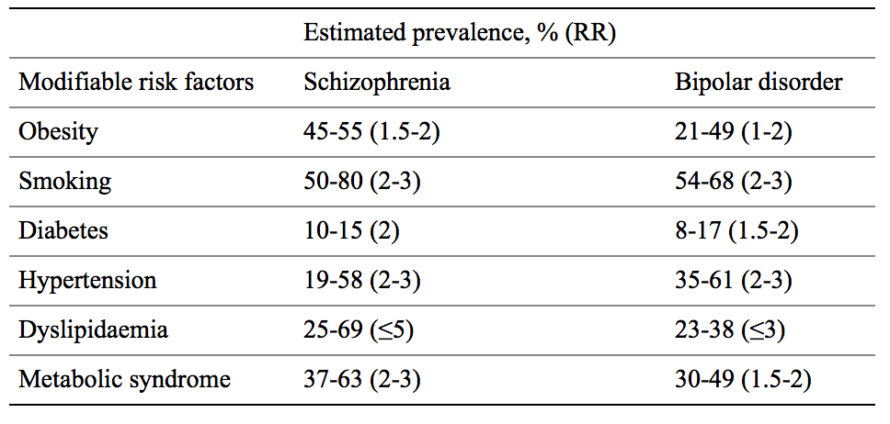
Mental Illness – Risk Factors
Estimated prevalence and relative risk (RR) of modifiable risk factors for cardiovascular disease in schizophrenia and bipolar disorder compared to the general population
De Hert (2007)

Slide 37
Role of an Exercise Physiology student on a MH Placement
General:
Challenge the ‘stigma’ associated with mental illness
Empower your clients through appropriate language
EP Specific:
Develop an understanding of the ‘profile’ of mental illness is Australia
Prevent, reduce &/or manage medication induced weight gain
Facilitate engagement in activities that promote a healthy lifestyle
Educate, measure and encourage reduction in risk factors, no matter what the cause
Understand the importance of contributing to a recovery-oriented service

Slide 38
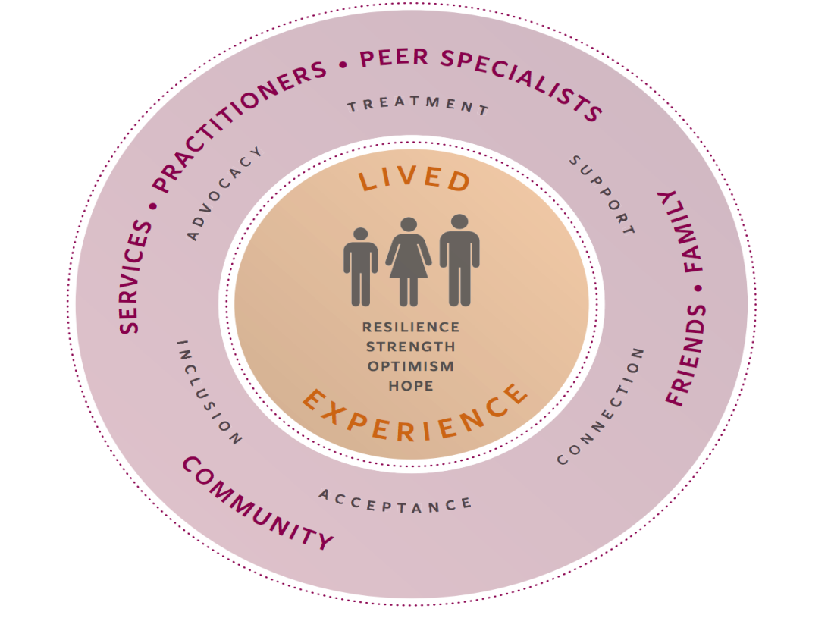
The concept of ‘recovery’
Began in the 1970s
An alternative to the ‘medical model’
The national framework for recovery oriented services defines personal recovery as:
‘being able to create and live a meaningful and contributing life in a community of choice with or without the presence of mental health issues’
Information & image sources from: A national framework for recovery-oriented mental health services:
Guide for practitioners and providers (2013)
Notes:
Whilst on placement, you may read and hear staff and consumer’s talking about recovery principles or recovery-oriented services.

Slide 39
Recovery Principles
Recovery principles guide the way we provide care
One of the underpinning principles is to provide hope & optimism
Recovery should be person-centered, and incorporate self-determination
Strengths-based model = focus on someone strengths
Recovery looks different for everyone. The journey can be long or short, ongoing, intermittent, etc.
Key principles:
Uniqueness of the Individual - Recognise that recovery isn't necessarily about a cure but about opportunities for choice and empowering individuals so care is person-centered.
Real Choices - Support & empower consumers to make their own choices
Attitudes and Rights - Promote and protect consumer's rights.
Dignity and Respect – Foster interactions that are courteous, respectful and honest. Challenge stigma.
Partnership and Communication – Assist consumers to build meaningful relationships.
Evaluating Recovery – Support consumers to evaluate their care
National Standards for Mental Health Services (2010)

Slide 40
How do I prepare for day one?
Research common diagnoses, how they present and understand the difference between them
Not sure where to start? Try these: anxiety, affective disorders, depression, schizophrenia, schizoaffective disorder, bipolar disorder, bipolar affective disorder, personality disorder)
Get familiar with common medications
Not sure where to start? Try these: antipsychotics – clozapine, aripiprazole, olanzapine, quetiapine; antidepressants – SSRIs, SNRIs, RIMAs, TCAs
Be willing to learn (trial and error)
If you’re going to an inpatient setting, read up on the Mental Health Act
Practice using the correct language
Have a pad and pen to jot down new terms/jargon you may hear
Read a little about what a recovery oriented service is- think about how you will provide an EP service within a recovery framework
If you are unsure, ask!
It is okay to be nervous, not okay to be judgemental
Online learning modules to be completed prior to day one
Expect the unexpected!

Slide 41
References
The Italian voice (2008) (Too much) Thinking.
Available from: https://www.flickr.com/photos/desiitaly/2193724466/in/photolist-4kRpRC-bx9pZH-dRzYUr-9EeC9r-dQWG4Q-gjCeLw-H6kg2-5bAiux-9xccP4-oueNEk-bCdhrY-gzvHnE-84aaqf-4EKcvW-bz982T-5zy9Lf-9oiCyZ-a4WoDN-jMkSMe-mfKa6a-9aHshG-8zjMf5-fN1qJz-6KaS5m-9zCsTG-ebdFgL-6uueN7-7vBAeW-5F8Vde-dfdMda-e9ixN7-dR1vJT-9dEs9Q-zFmJec-4VaLtJ-4Kj55G-8gxKrS-ycm97k-gTEbNh-4CgjiQ-kJXpTc-ajqLbo-fRYsoz-ABBdEG-bRXGae-cgkeDQ-2prog6-753iMj-NMdwZ-pA9Wr6 (accessed on 29/11/2015
Keith Persall (2014) Freckles.
Available from: https://www.flickr.com/photos/persall/ (accessed on 29/11/2015)
David Goehring (2010) Enthusiam Uncurbed.
Available from: https://www.flickr.com/photos/carbonnyc/4318504691 (accessed on 29/11/2015)
Sane Australia (2015) Mental Illness: Dispelling the Myths
Available from: https://www.sane.org/mental-health-and-illness/facts-and-guides/mental-illness-dispelling-the-myths (accessed on 29/11/2015)
Government of Western Australia Mental Health Commission (2010) Common myths about mental illness
Available from: http://www.mentalhealth.wa.gov.au/mental_illness_and_health/Myths_mental_illness.aspx (accessed on 29/11/2015)
Hugs, R. (2013) Helpful Advice. [Cartoon] Robot Hugs.
Available from http://www.robot-hugs.com (accessed on 29/11/2015)
University of Oxford (2014) Mental Health: ethnic minority carers’ experiences Available from: http://www.healthtalk.org/peoples-experiences/mental-health/mental-health-ethnic-minority-carers-experiences/negative-attitudes-mental-health-problems (accessed on 29/11/2015)

Slide 42
Stuart H. (2013) Violence and mental illness: An overview. World Psychiatr. 2003;2:121–4.
Treatment Advocacy Centre (2011) Violent Behaviour: one of the consequences of failing to treat people with serious mental illness
Available from: http://www.treatmentadvocacycenter.org/resources/consequences-of-lack-of-treatment/violence/1381(accessed on 29/11/2015)
Australian Institute of Health and Welfare 2014. Australian hospital statistics 2012–13. Health services series no. 54. Cat. no. HSE 145. Canberra: AIHW.
Available from: https://mhsa.aihw.gov.au/services/admitted-patient/ (accessed on 29/11/2015)
NSW Mental Health Commission (2014). Living Well: Putting people at the centre of mental health reform in NSW. Sydney, NSW Mental Health Commission
Available from: http://nswmentalhealthcommission.com.au/node/1586 (accessed on 29/11/2015)
Mindframe (2014) Facts and Stats about Mental Illness in Australia
Available from: http://www.mindframe-media.info/for-media/reporting-mental-illness/facts-and-stats (accessed on 29/11/2015)
Lambert (2013) HWA Interdisciplinary video conference: Cardiometabolic Health in Psychosis
Available from: http://ccchip.com.au/wp-content/uploads/2014/03/HWA-Handout-Slides.pdf (accessed on 29/11/2015)
SANE Australia (2015) Facts 7 Figures
Available from: https://www.sane.org/mental-health-and-illness/facts-and-guides/facts-figures (accessed on 29/11/2015)
World Health Organisation (2015) Premature Death among people with severe mental disorders [factsheet]
Available from: http://www.who.int/mental_health/management/info_sheet.pdf (accessed on 29/11/2015)
Alvarez-Jimenez (2008) Antipsychotic-induced weight gain in chronic and first-episode psychotic disorders: a systematic critical reappraisal. CNS Drugs 22: 547–562.

Slide 43
Correll, C. (2009) Cardiometabolic risk of second-generation antipsychotic medications during first-time use in children and adolescents. JAMA : The Journal of the American Medical Association, 302(16), 1765–1773.
Available from: http://doi.org/10.1001/jama.2009.1549 (accessed on 29/11/2015)
Thakore JH (2002) Increased visceral fat distribution in drug-naive and drug-free patients with schizophrenia. International Journal of Obesity & Related Metabolic Disorders. 26:137–141
Thakore, J (2014) Severe mental illness: biological effects [internet] Diapedia 61047161723 rev. no. 8
Available from: http://www.diapedia.org/associated-disorders/61047161723/severe-mental-illness-biological-effects accessed on 29/11/2015)
National Institute of Mental Health (2009) Schizophrenia
Accessed from: http://www.nimh.nih.gov/health/publications/schizophrenia/schizophrenia-booket-2009_34643.pdf (accessed on 29/11/2015)
De Hert, (2007) Physical illness in patients with severe mental disorders. I. Prevalence, impact of medications and disparities in health care World Psychiatry. 2011 Feb; 10(1): 52–77
Commonwealth of Australia (2013) A national framework for recovery-oriented mental health services: Guide for practitioners and providers
Available from: http://www.health.gov.au/internet/main/publishing.nsf/content/mental-pubs-n-recovgde (accessed on 29/11/2015)
Commonwealth of Australia (2010) National Standards for Mental Health Services: Principles of recovery oriented mental health practice
Available from: https://www.health.gov.au/internet/main/publishing.nsf/content/CFA833CB8C1AA178CA257BF0001E7520/$File/servpri.pdf j (accessed on 26/11/2015)

Slide 44
Activity One
Warning: this may be distressing for some students. Listening to the audio is optional.
Activity A:
Split into groups of two
Person one: Access links below with head phones. Answer questions being asked by person two
https://www.youtube.com/watch?v=0vvU-Ajwbok
Person 2: Read from script provided to Person 1
Activity B:
All students listen to audio and answer questions as prompted by youtube video. Start video at 1.59
https://www.youtube.com/watch?v=Q7ZSDeec41U

Slide 45
Activity Two
Split the room into two groups.
Group 1: Watch circumstances of two clients presenting to a mental health ward (e.g. Michelle and Nathan from the ‘Inside Story’)
Group 2: Watch mental health tribunal scene
Groups teach each other about various ways patients present to hospital, the role of the Mental Health Act and the role of the Mental Health Tribunal

